Slide 1

The Network Layer lec 20-3 The Distance-Vector Routing
School of Software Engineering
South China University of Technology
Dr. Chunhua Chen
chunhuachen@scut.edu.cn
2020 Spring

Slide 2
The Distance-Vector (DV) Routing Algorithm
Distributed
each node receives some information from one or more of its directly attached neighbors, performs a calculation, and then distributes the results of its calculation back to its neighbors
Iterative
this process continues on until no more information is exchanged between neighbors
Asynchronous
it does not require all of the nodes to operate in lockstep with each other.

Slide 3

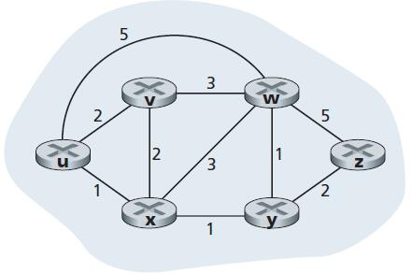
Bellman-Ford equation
d_{x}(y) be the cost of the least-cost path from node x to node y.
where the min_{v} in the equation is taken over all of x’s neighbors
d_{u}(z): (u, x) (x, y) (y, z) = 4
Neighbor of u: v, w and x
1. c(u,v)+d_{v}(z)
2. c(u,w)+d_{w}(z)
3. c(u,x)+d_{x}(z)

Slide 4
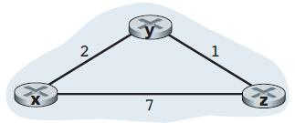
The DV Algorithm
Each node x begins with D_{x}(y), an estimate of the cost of the least-cost path from x to node y, for all nodes in N.
D_{x} = [D_{x}(y): y in N] be node x’s distance vector, which is the vector of cost estimates from x to all other nodes, y, in N.
D_{z} = [D_{z}(x), D_{z}(y), D_{z}(z) ]
= [7, 1, 0 ]

Slide 5
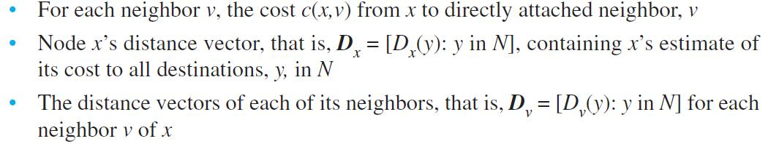
The DV Algorithm
With the DV algorithm, each node x maintains the following routing information:

Slide 6
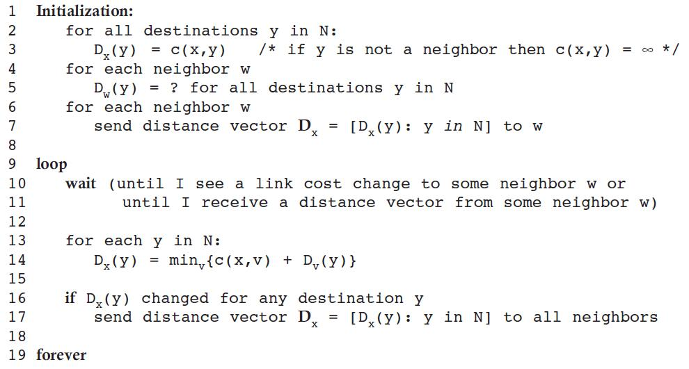
The DV Algorithm run by node x

Slide 7
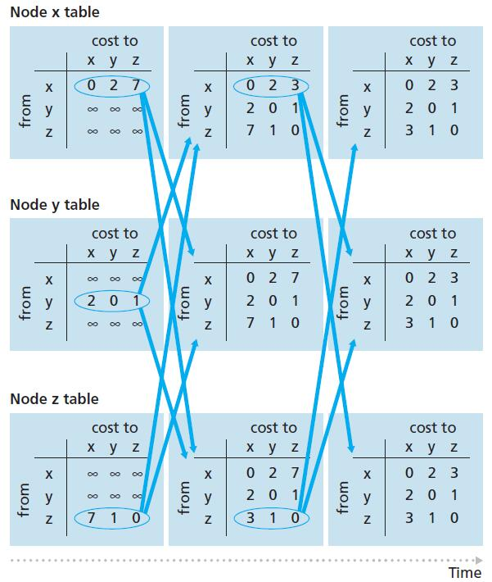
The DV algorithm is decentralized and does not use such global information.
Indeed, the only information a node will have is the costs of the links to its directly attached neighbors and information it receives from these neighbors.

Slide 8
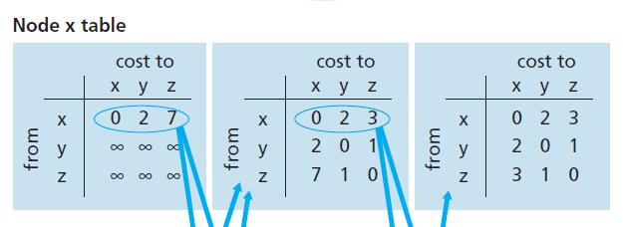
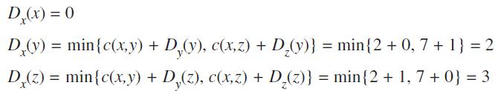
At node x, after receiving updates

